Slide 1
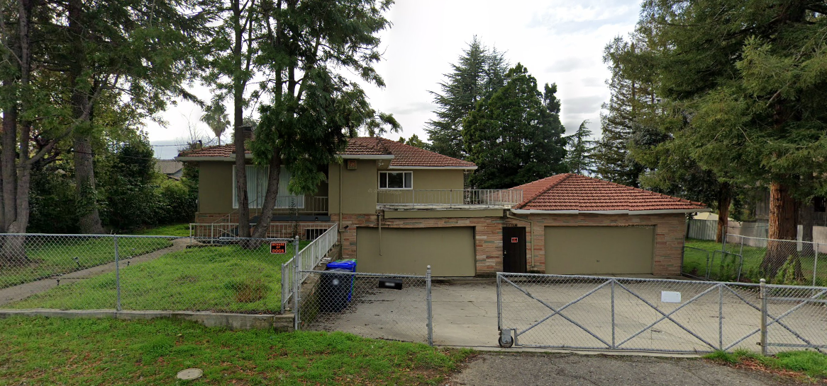
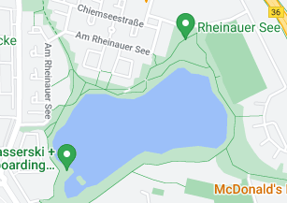
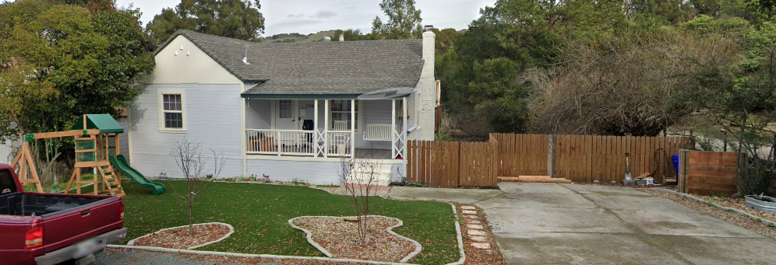
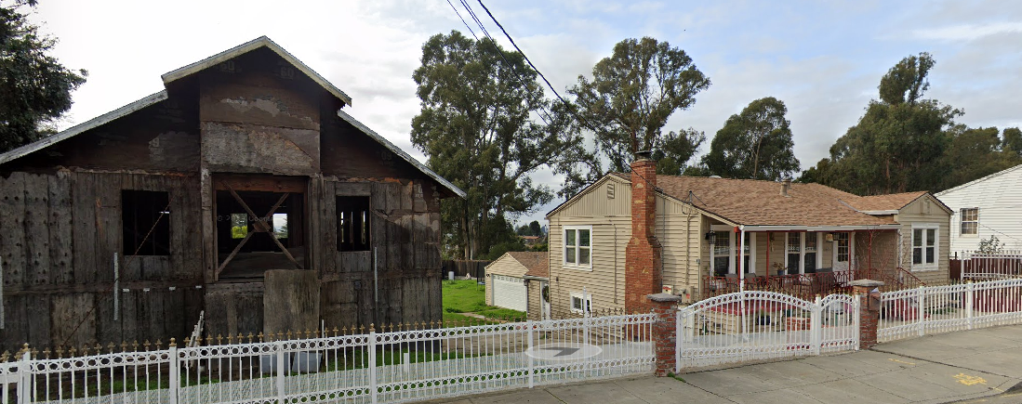
FBI
development
FBI:HOMICIDE
1/87
1991
Austria
HOMICIDE:KYSTAL
MARY.lisnti(killed by slanted garage entyr way
IMPORT HOMCIDE:KYSTAL:SQ:COLEMEN
IPX HOMCDI:KYSTAL:SQ:COLMAN:DE
2000/1 - 2017
1995/6
mannheim
Gustav-Nachtigal-Straße 51A,
68219 Mannheim, Germany
LARRY.sport(becker,Agassi,graf)
killed by slanted garage entyr way
Eric Smidt
Alpha romeo
FEDLERA.JFK(BERLIN ZOO).IPX
CPVA
Peterson Black Chur
Ghohceo(Jackson)
2000-2023 23Y
IMPORT Phically pull DEA(apple-visa(trailer))
zoo
[x] no

Slide 2

FBI
development
POLCI COURT
HAMITION
CPVA.INTERNET PAYMENT
3-way David Hanson
1986/7
JACK
FBI:WMD(ootsie)
1
3
2011
Apple Fremon High Touch
2
2010
PRSION SAINT (Fremont)
Touch.accentuer.damiler.ibm.roth
C5 tattto cocain
Garage, bananawiezen us/ru IMPORT

Slide 3


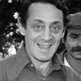

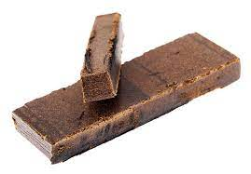

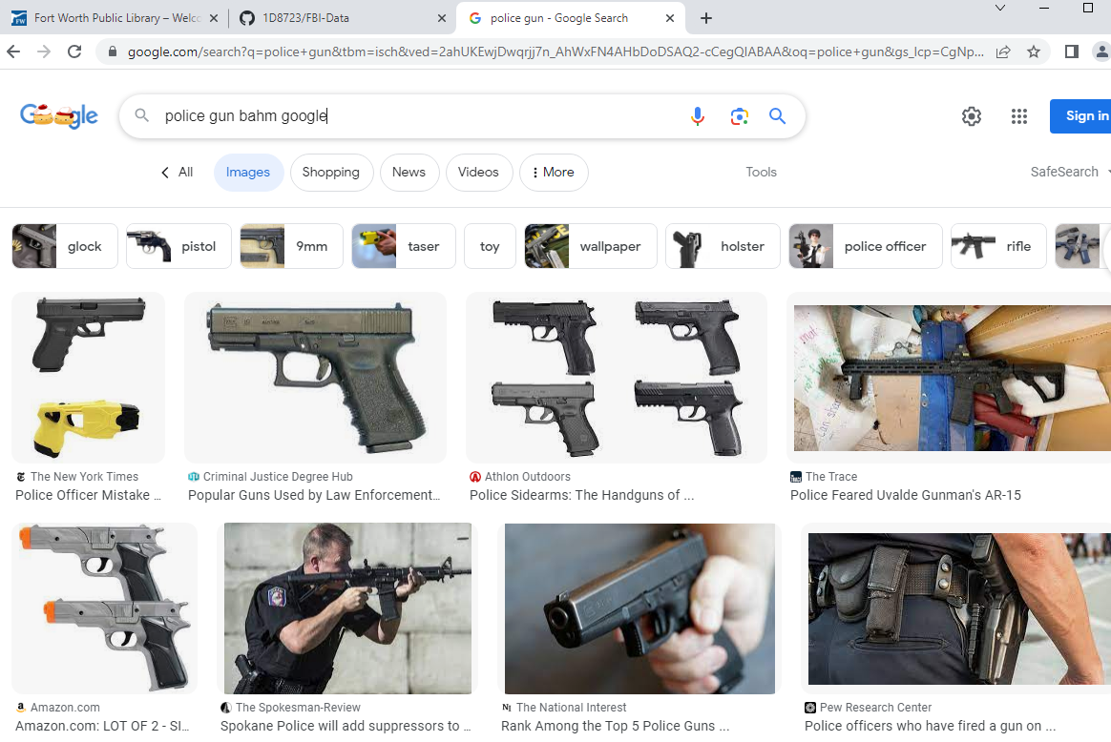
FBI
development
FBI DEA
1995/6
nonPolizeiAuschitz(furniss)
Gov Sch.
HOMCIDE:LUX(twins[])
IPX IMPORT
2005/6
IBM Redbooks
Tivoli, Austin, Texas
Lake Tahoe
HOMICDE:BILL.avg.”parker”
HOMICIDE:KRSTAL
Bird johan x/y krstalglas
PARKER
Nadie Mithcel
Nacidn Parker
Johjsnan Paker
Tana parker
IMPORT
INTENT PAYMENS HOMCE:LUX:Hatehole(jeff hass)
§Possesion
000.tw.pns.(cobra beer)
NAME CHANGE
(frea pizza)
HOMCID:MAYRO
FEDER VP GERMAY CHINA Kahn
§Stalking
ATOMICLCOK(FBI:WMD)
LARRY.high
POLICE
FBI Shooter for Town
Remote googl bahm
Gorbach(Micel(

Slide 4
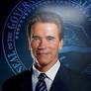

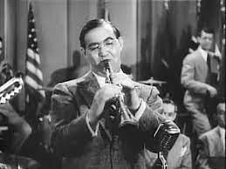
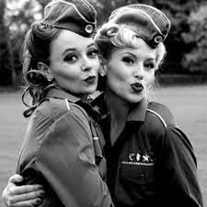
FBI
development
PARKER
Nadie Mitcel
Nacidn Parker
Johantnan Paker (VIRGINIA goldman sachs Johnathan)
Prosteatin Law
Gorbachev( )
IMPORT INTERNET PAYMENTS Tana parker
MUSIC

Slide 5


FBI
development
1995/6 88th
WWI.HOMCIDE:CHANLOR: §31 Kondomflicht
Fly, West googl bahm
Gorbahce(
Nadine michl
POLICE

Slide 6


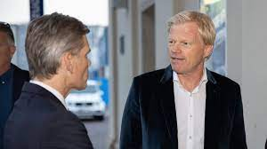


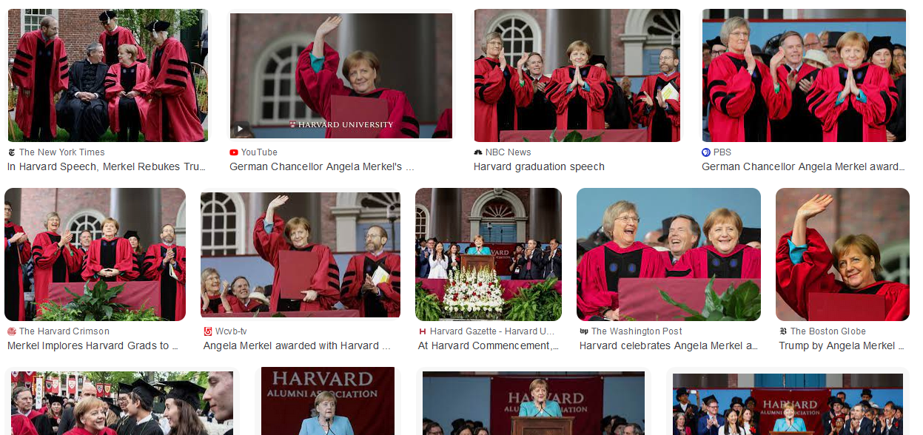
FBI
development
2000
WATER.IPX.WAR(B-10).PHILLS.WHITEHOUSE
41.
Social Worker taking care of herion addit
For other coutnry
Phil.JFK.MLK(tv)
CPVA Apple NAME CHANE(free pizza)
movie outsourcing
penis ego
Auto Soul ertec penis NAME CHANG(free pizza)
Touch.Accenture.damiler.ibm.roth
steve jobs gay pensie fight
nonPoliceRTA(facebook)
NAME CHANGE(free pizza)
Busines peop pensie so big from ousouign
Apple pensie fight
gta
Tim cook gary
stephanie
x
Internation audince

Slide 7
FBI
development

